Slide 1



GRAPHICS AND VISUAL COMPUTING PROJECT
ARATRIKA CHAKRABARTI
22CS3014
ARCHITA AGRAHARI
22CS3015

Slide 2
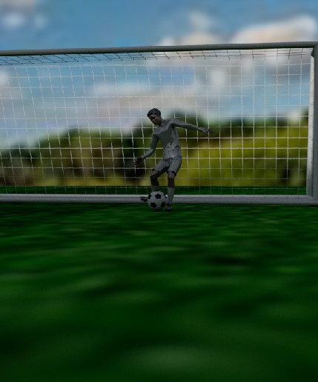
DYNAMIC MOTION VIEW OF A SOCCER GOAL KEEPER
The project involved a comprehensive integration of various elements such as a soccer ground, goalpost mesh, football, a rigged character animation from the Mixamo site, field coloring with added texture, keyframe animation for the football, and the use of multiple lights, camera motion curves, and high-resolution rendering.

Slide 3
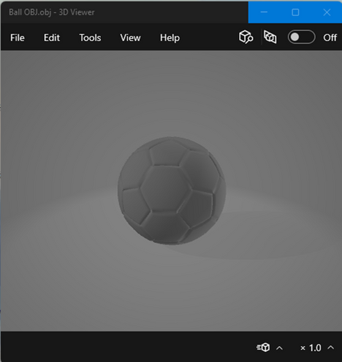
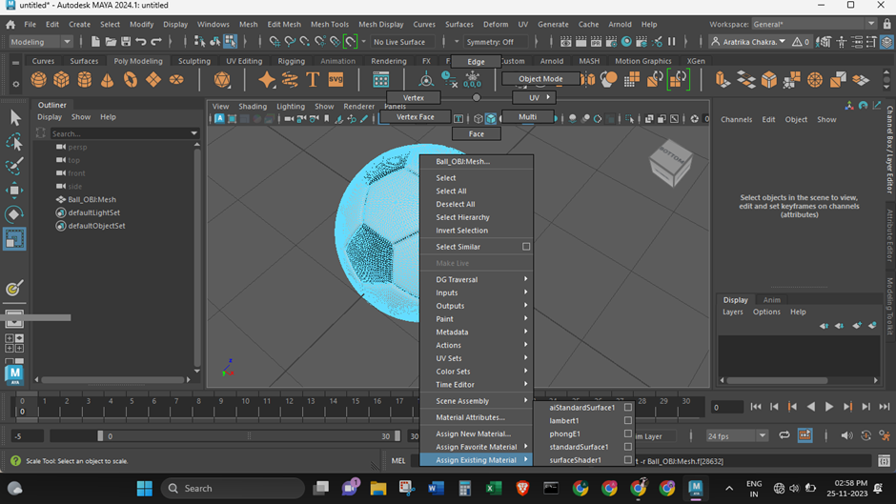
CREATING OBJECTS :
FOOTBALL
ADDING COLOUR AND TEXTURES TO THE BALL

Slide 4
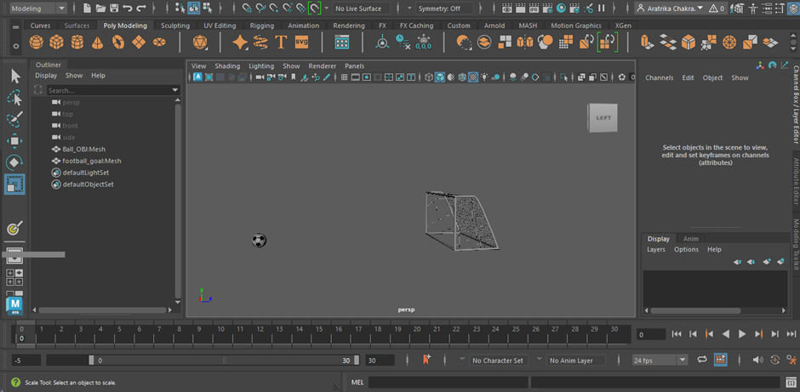
CREATION OF GOALPOST

Slide 5
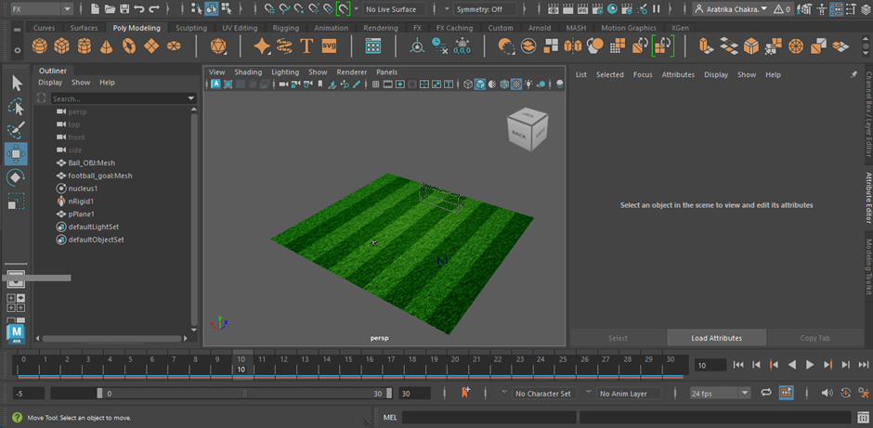
CREATION OF SOCCER GROUND

Slide 6
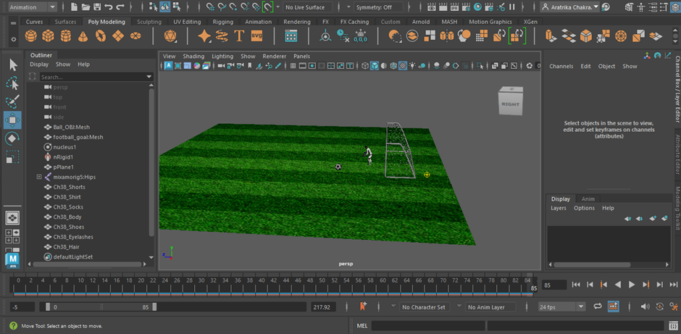
ADDITION OF RIGGED CHARACTER

Slide 7
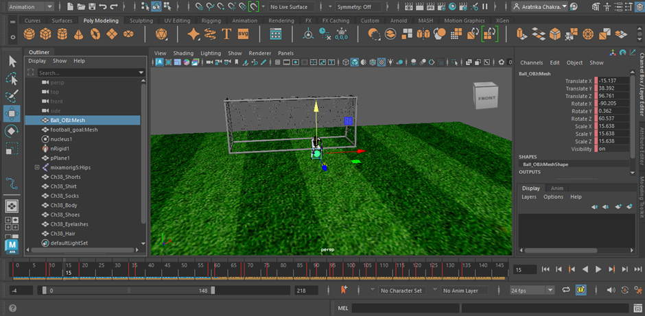
ANIMATION OF BALL AT VARIED POSITION USING KEYFRAMES

Slide 8
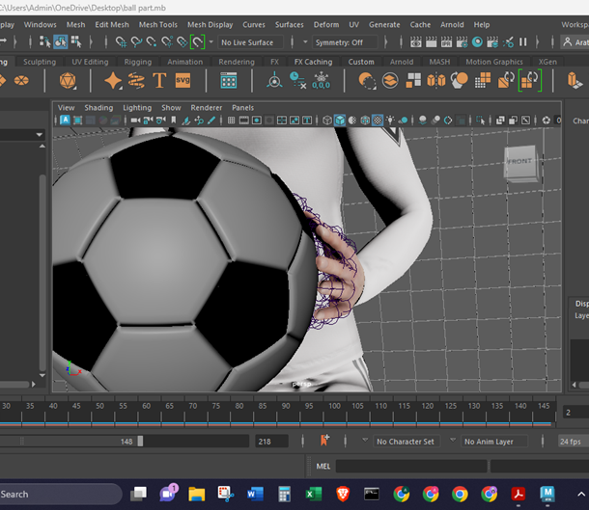
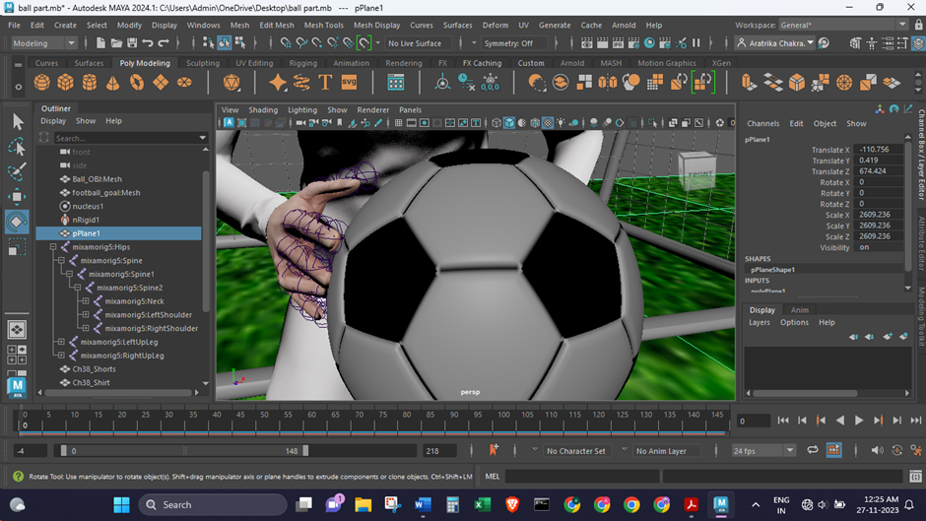
ANIMATION OF RIGGED CHARACTER

Slide 9
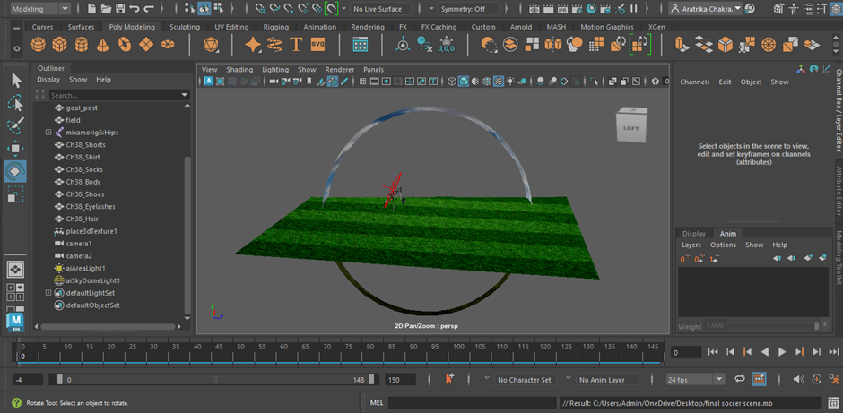
ADDING LIGHTS TO THE SCENE:
SKYDOME LIGHT
AREA LIGHT

Slide 10
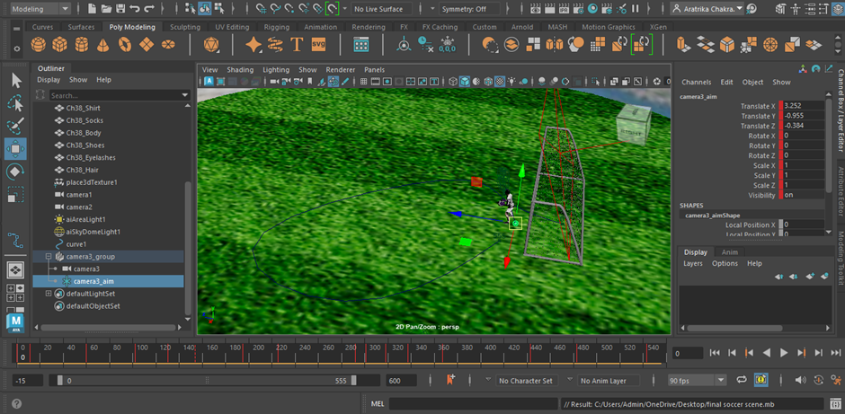
ADDING CAMERA WITH AIM

Slide 11
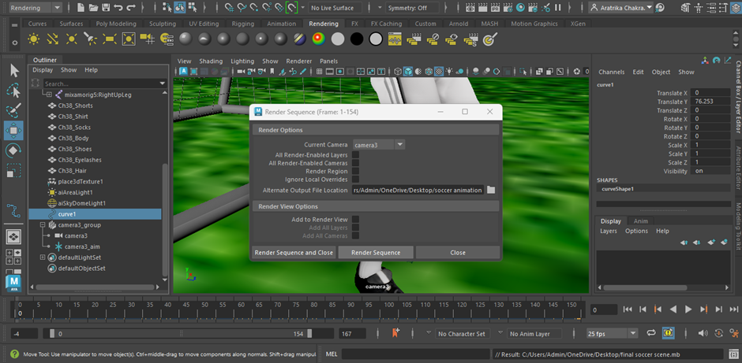
RENDERING ANIMATION

Slide 12
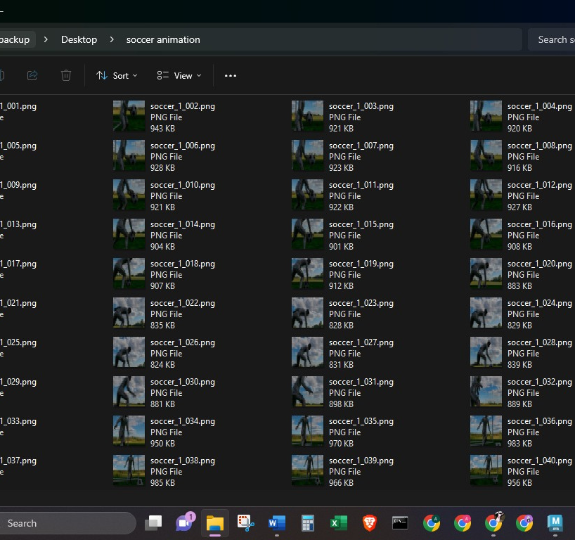
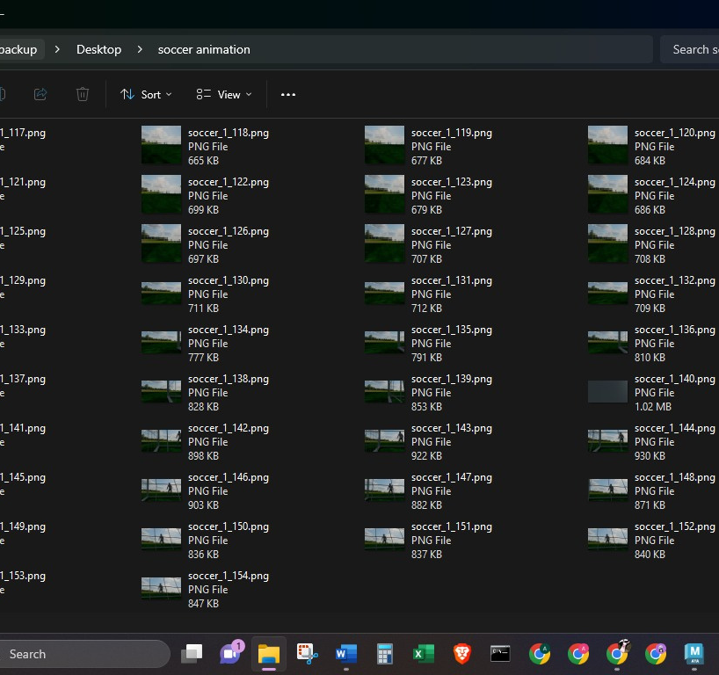
RENDERED FILES

Slide 13
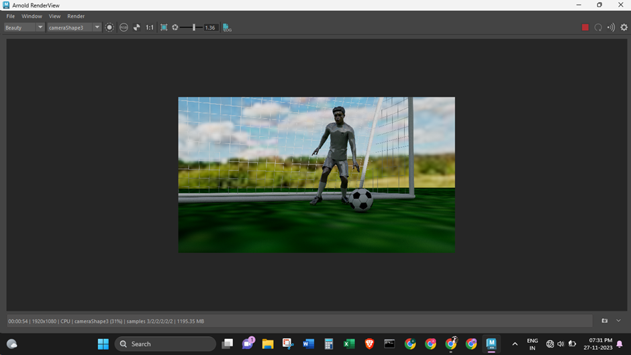
RENDERED IMAGE

Slide 14
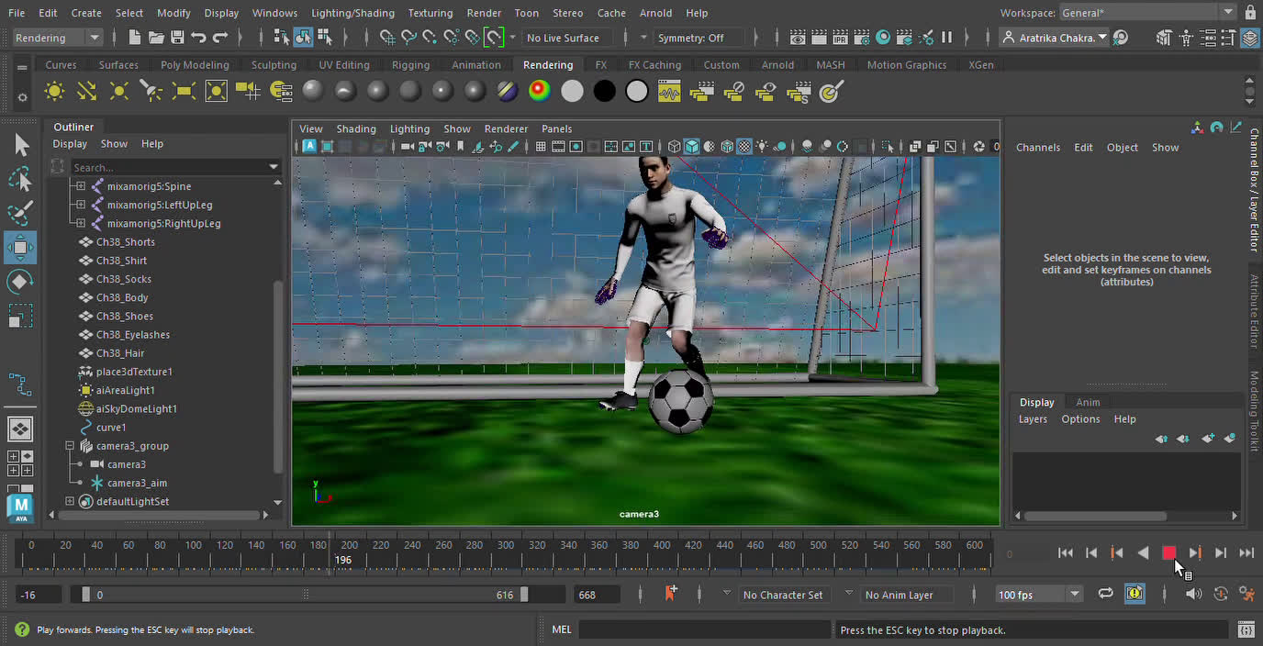
ANIMATED VIDEO THROUGH
MOTION CAMERA

Slide 15
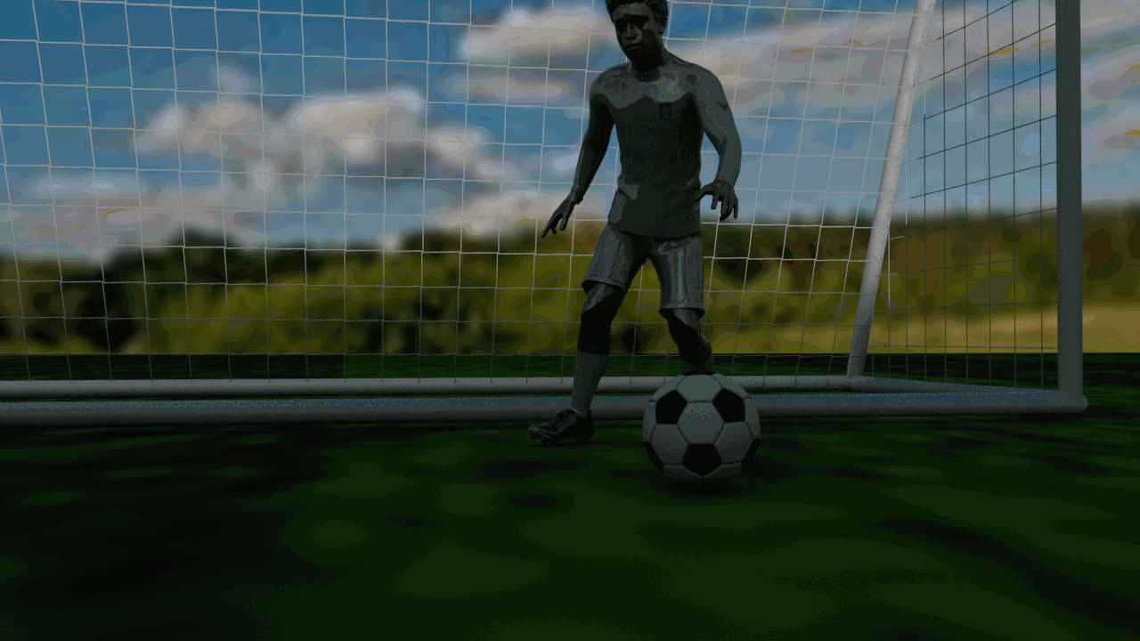
RENDERED ANIMATION SEQUENCE

Slide 16

THANK YOU

